Slide 1
Course Name: Fundamental of Electronics Engineering
By Dr Shivani Sharma

Slide 2
Text Books:
1. Robert L. Boylestand / Louis Nashelsky “Electronic Devices and Circuit Theory”, Pearson
Education.
2. George Kennedy, “Electronic Communication Systems”, McGrawPublication
3. Jacob Millman, C.C. Halkias, StayabrataJit, “Electronic Devices and Circuits”, McGrawHill.

Slide 3
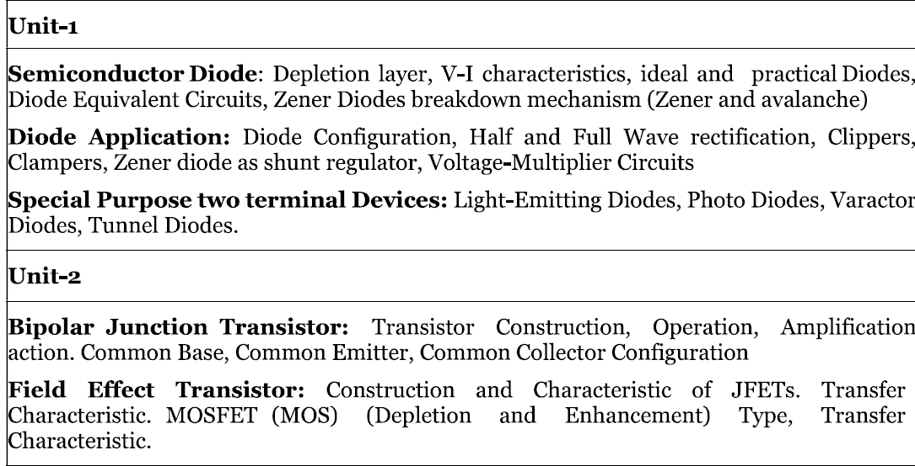

Slide 4
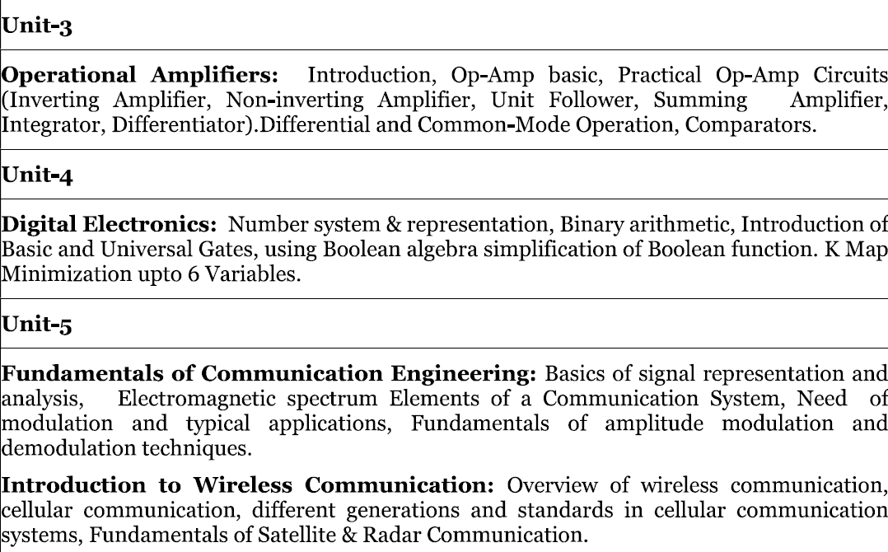

Slide 5

Introduction to Electronics
Electronics is composed of physics, engineering, technology and applications.
The field of electronics deals with the emission, flow and control of electrons in vacuum and matter. Electronic use active devices to control electron flow by amplification and rectification.
Electronics distinguishes itself from classical electrical engineering that uses passive effects like resistance, capacitance and inductance to control current flow.

Slide 6
Introduction to Electronics Engineering
Definition: Electronics Engineering is a branch of engineering that deals with the design, development, and application of electronic devices and circuits. It encompasses a range of technologies involving semiconductors, transistors, and integrated circuits.
Importance:
Everyday Life: Powers household appliances, smartphones, computers.
Industrial Applications: Automation, control systems.
Communication: Telecommunication systems, internet infrastructure.
Healthcare: Medical devices and diagnostics

Slide 7
Emerging Trends and Future Directions
1. Internet of Things (IoT): IoT connects everyday devices to the internet, allowing them to collect, exchange, and act on data.
Applications: Smart homes, industrial automation (IIoT), healthcare (wearable devices), agriculture, and smart cities.
Key Technologies: Low-power sensors, microcontrollers, wireless communication (e.g., 5G, Wi-Fi 6), edge computing.
2. 5G Technology: 5G is the next-generation cellular network technology offering faster speeds, lower latency, and greater capacity than 4G.
Application Areas: Telecommunications, smart cities, autonomous driving, industrial automation, remote healthcare.
3. Wearable Electronics: The growing trend of wearable devices for fitness, healthcare, and entertainment.
Examples: Smartwatches, fitness trackers, smart glasses, health monitors (ECG, heart rate, SpO2).
4. Integrated Circuits and Microelectronics:
  Advancements: Smaller, more powerful chips.
  Applications: Smartphones, wearables.

Slide 8


UNIT – 4 DIGITAL ELECTRONICS
Digital electronics is a field of electronics that deals with digital signals, where data is represented in discrete levels or states, usually as binary values (0s and 1s). Unlike analog electronics, which uses continuous signals, digital electronics operates on digital signals that have distinct high and low states.

Slide 9
TOPICS TO BE DISCUSSED
1
Number Systems & representation
2
Binary Arithmetic
3
Intro to basic gates & universal gates
4
Boolean algebra
5
K Maps – 6 variables

Slide 10
Feature | Digital Electronics | Analog Electronics
Signal Type | Discrete (binary: 0 and 1) | Continuous (varies smoothly over a range) (voltages, currents)
Noise Susceptibility | Less susceptible to noise and signal degradation | More susceptible to noise and distortion
Circuit Components | Logic gates, flip-flops, microprocessors | Resistors, capacitors, inductors, transistors
Complexity | Higher design complexity, easier to scale | Simpler circuits but harder to scale for complex functions
Processing Speed | Generally faster for complex operations | Slower due to continuous signal processing
Power Consumption | Generally lower in idle state, but may vary depending on usage | Typically higher, continuous power usage
Applications | Computers, digital watches, smartphones, digital communication | Audio amplifiers, radio transmitters, analog sensors
Design Flexibility | Highly flexible, easy to replicate and modify | Less flexible, harder to replicate without distortion
Conversion | Requires Analog-to-Digital (ADC) and Digital-to-Analog Converters (DAC) | Direct processing without conversion needed
Cost | Generally lower for large-scale production | Can be higher for high-precision component

Slide 11
Types of Number Systems
There are various types of number systems in mathematics. The four most common number system types are:
Decimal number system (Base- 10, 0,1,2,3,4,5,6,7,8 and 9 ). 723₁₀, 32₁₀, and 4257₁₀
Octal number system (Base-8, 0,1,2,3,4,5,6 and 7). For example, 35₈, 23₈, and 141₈
Hexadecimal number system (Base- 16, 0,1,2,3,4,5,6,7,8,9 and A,B,C,D,E,F). For example, 7B3₁₆, 6F₁₆, and 4B2A₁₆
Binary number system (Base- 2, 0 and 1). For example: 10001₂, 111101₂, 1010101₂

Slide 12
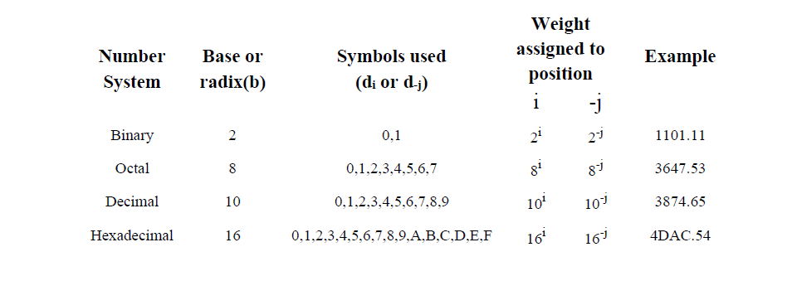
Number Systems & representation

Slide 13
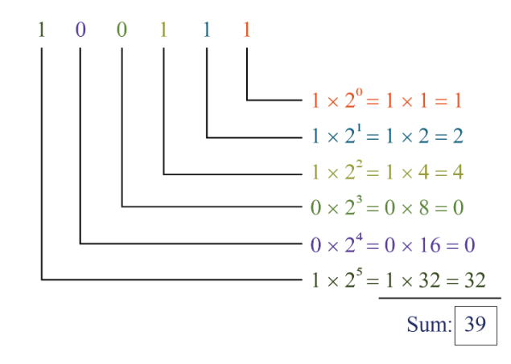
Any other number system to Decimal Conversion
Here Binary no. system, therefore, base is 2

Slide 14
Any other number system to Decimal Conversion
Examples:
1. Convert binary (10101)2 to decimal.
2. Convert binary (10110.001)2 to decimal.

Slide 15
Decimal to Other number system
For converting decimal to any other system, there are two steps required to perform, which are as follows:
Divide the given number by 2.
Get the integer quotient for the next iteration.
Get the remainder for the digit.
Repeat the steps until the quotient is equal to 0 or indivisible no.
Examples:
Convert (13)10 to binary:
Division by 2 Quotient Remainder
13/2 6 1(LSB)
6/2 3 0
3/2 1 1
1 1
So, (13)10 = (1101)2

Slide 16
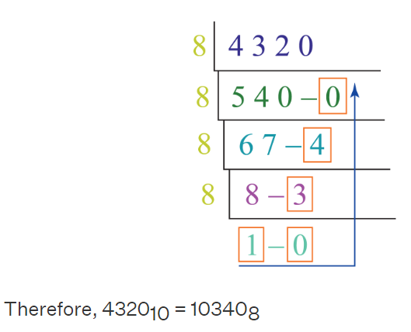
Decimal to Other number system
Decimal to Octal

Slide 17
Convert (152.25)10 to binary
Solution:
Step 1: Divide the number 152 and its successive quotients with base 2.
Divide by 2 Quotient Remainder
152/2 76 0 (LSB)
76/2 38 0
38/2 19 0
19/2 9 1
9/2 4 1
4/2 2 0
2/2 1 0
(152)10=(10011000)2
Step 2: Now, perform the multiplication of 0.25 and successive fraction with base 2.
0.25×2 0.5 0
0.50×2 1 1
(0.25)10=(.01)2
So, (152.25)10 = (10011000.01)2
NOTE: When we get the whole no. in result then we stop the multiplication.

Slide 18
Example 1: Find the binary fraction equivalent of 0.125₁₀
We multiply 0.125 by 2 and take the integer part
0.125 x 2 = 0.250
Integer part = 0, Fractional part = 0.250
0.125 × 2 = 0 + 0.25
0.250 × 2 = 0 + 0.5
0.500 × 2 = 1
The calculated integer part are as followed.
Step 1: 0
Step 2: 0
Step 3: 1
Thus the binary equivalent of 0.125₁₀ is 0.001.
Example 2: 0.6875₁₀ = 1011₂
0.6875 × 2 = 1 + 0.375
0.3750 × 2 = 0 + 0.75
0.75 × 2 = 1 + 0.5
0.50 × 2 = 1 + 0

Slide 19
Other Number system to Other number system
Example 1:
Convert (1056)₁₆ to an octal number.
Solution:
Given, 1056₁₆ is a hex number.
First we need to convert the given hexadecimal number into decimal number
(1056)₁₆
= 1 × 16³ + 0 × 16² + 5 × 16¹ + 6 × 160
= 4096 + 0 + 80 + 6
= (4182)₁₀
Now we will convert this decimal number to the required octal number by repetitively dividing by 8.
Therefore, taking the value of the remainder from bottom to top, we get;
(4182)₁₀ = (10126)₈
(1056)₁₆ = (10126)₈

Slide 20
STEP 2:
33 / 2 16 1
16 / 2 8 0
8 / 2 4 0
4 / 2 2 0
2 / 2 1 0
1 / 2 0 1
Therefore, the equivalent binary number is 100001.
Hence, 41₈ = 100001₂
Q.1: Convert 41₈ to a binary number.
Solution:
STEP 1: Given number is 41₈
41₈ = (4 * 8¹) + (1 * 8⁰)
= 4 * 8 + 1 * 1
= 32+1
= 33(Decimal number)

Slide 21
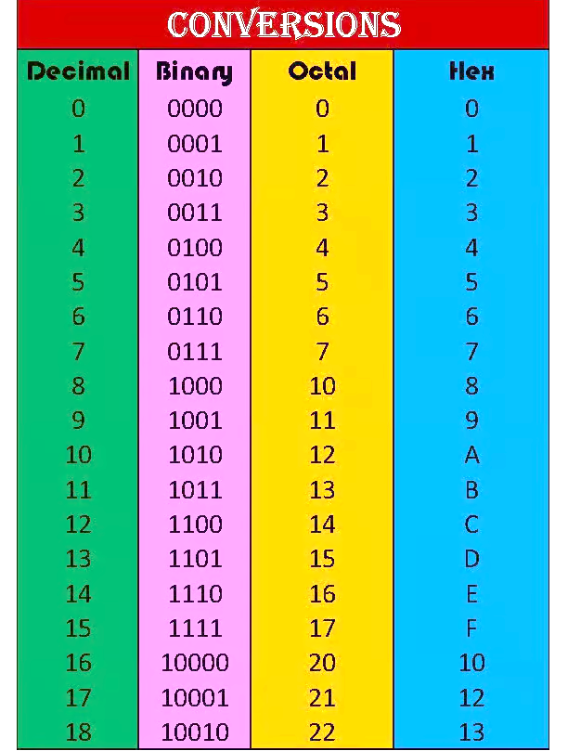

Slide 22
Binary Arithmetic
Logic Addition
0 + 0 =0
0 + 1 =1
1 + 0 =1
1 + 1 =0 Carry 1
Logic Subtraction
0 - 0 =0
0 - 1 =1 Borrow 1
1 - 0 =1
1 - 1 =0
Logical Multiplication
0.0 = 0
0.1 = 0
1.0 = 0
1.1 = 1
Logical Division
1÷1 = 1
1÷0 = ND/ Meaningless
0÷1 = 0
0÷0 = N/D Meaningless

Slide 23
Binary Subtraction using Complements (1s & 2s)
1's Complement: 1's Complement can be obtained by simply altering 1s to 0s and 0s to 1s. For eg, 1's Complement of (1001) is (0110).
Procedures for Binary Subtraction by 1’s Complement
Write the 1’s complement of the subtrahend
Then add the 1’s complement subtrahend with the minuend
If the result has a carryover, then add that carry over in the least significant bit
If there is no carryover, then take the 1’s complement of the resultant, and it is negative.

Slide 24
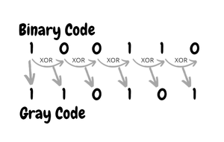
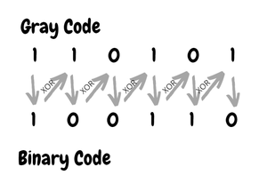
BINARY TO GRAY & GRAY TO BINARY
Keep the 1st bit

Slide 25
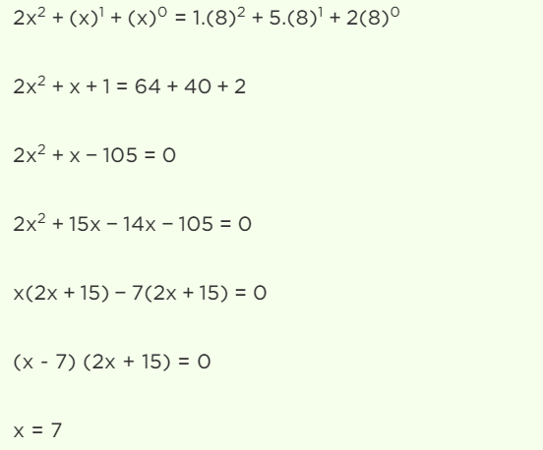
QUES

Slide 26
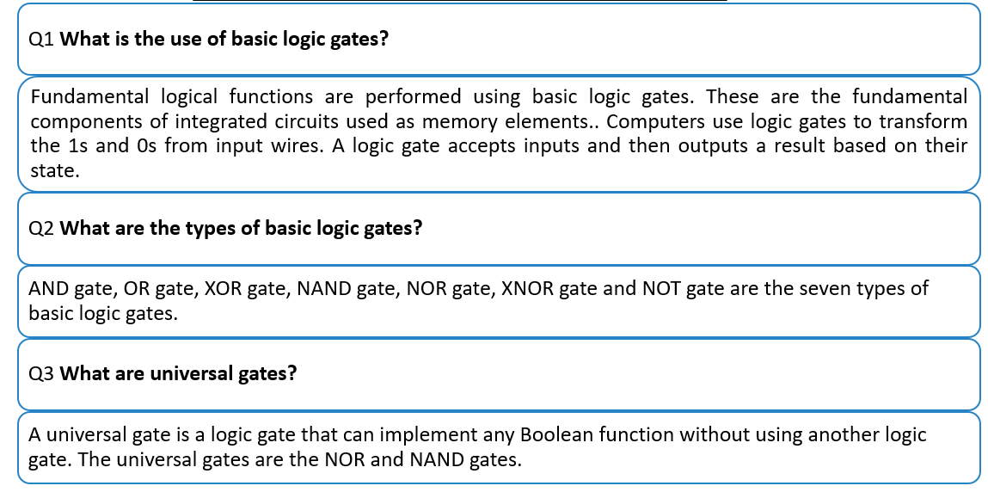
Basic and Universal Logic Gates

Slide 27

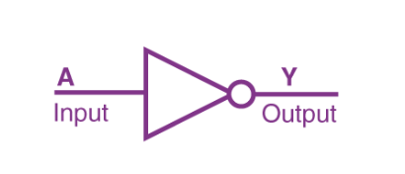
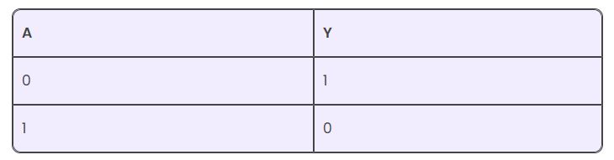
NOT
The Boolean expression is
It is read as Y equals NOT A.
The truth table of NOT gate is as follows

Slide 28
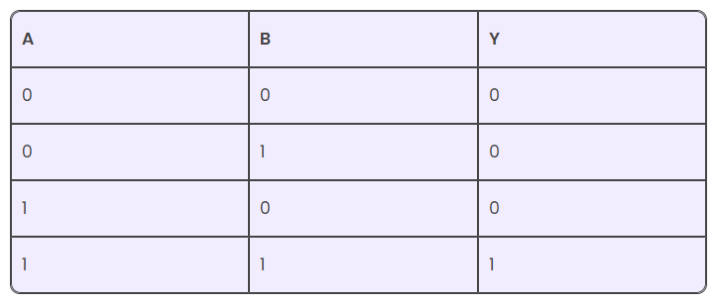
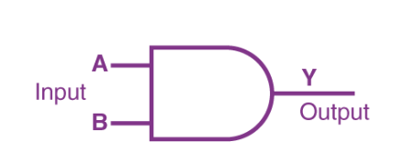
AND
The Boolean expression of AND gate is Y = A.B
The truth table of a two-input AND basic gate is given as

Slide 29

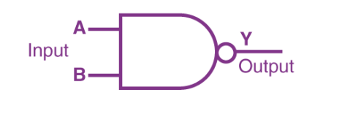
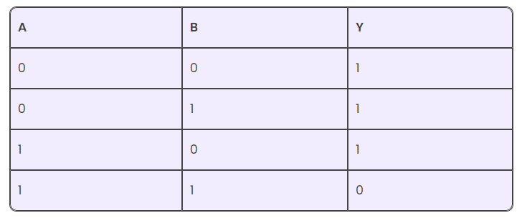
NAND
The Boolean expression of the NAND gate is
The truth table of a NAND gate is given as

Slide 30
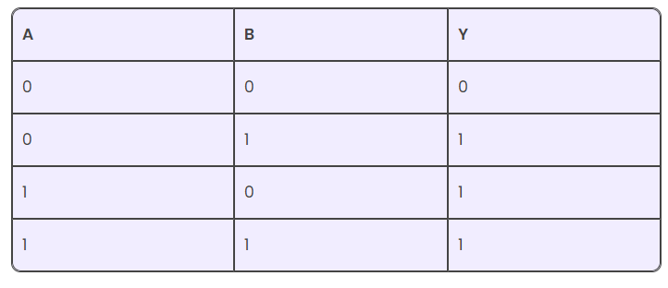
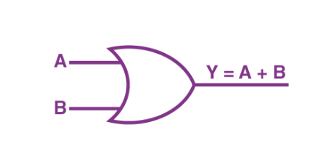
OR
The Boolean expression of the OR gate is Y = A + B, read as Y equals A ‘OR’ B.
The truth table of a two-input OR basic gate is given as

Slide 31

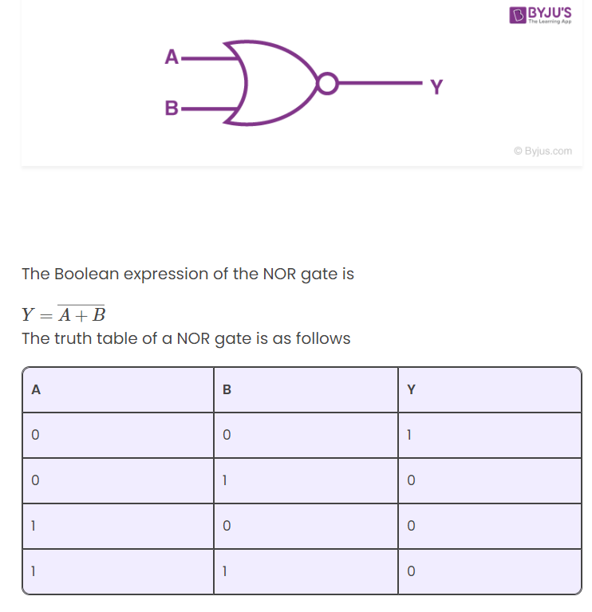
NOR
The Boolean expression of the NOR gate is
The truth table of a NOR gate is given as

Slide 32

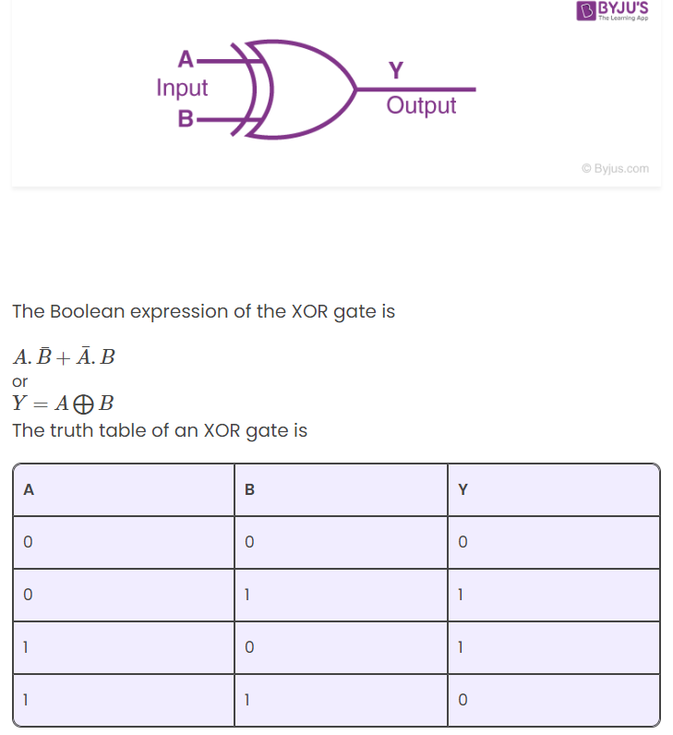
X OR
The Boolean expression of the XOR gate is
The truth table of a XOR gate is given as

Slide 33

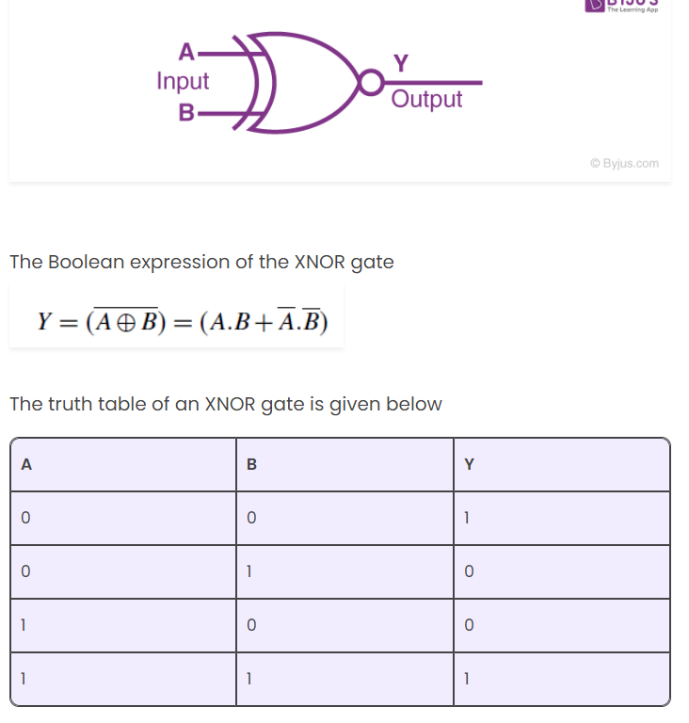
X NOR
The Boolean expression of the XNOR gate is
The truth table of a XNOR gate is given as

Slide 34
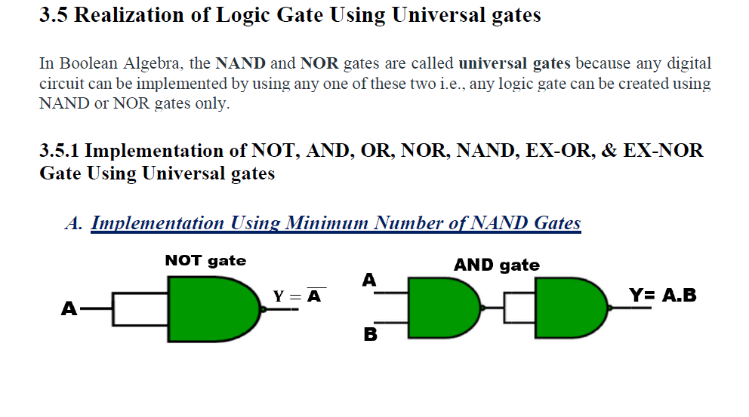
NOT using NAND
AND using NAND
OR using NAND

Slide 35
B. Implementation Using Minimum Number of NOR Gates

Slide 36
Boolean algebra
Boolean Algebra: Boolean algebra is the branch of algebra that deals with logical operations and binary variables.
Boolean Variables: A Boolean variable is defined as a variable or a symbol defined as a variable or a symbol, generally an alphabet that represents the logical quantities such as 0 or 1.
Boolean Function: A Boolean function consists of binary variables, logical operators, constants such as 0 and 1, equal to the operator, and the parenthesis symbols.
Truth Table: The truth table is a table that gives all the possible values of logical variables and the combination of the variables. It is possible to convert the Boolean equation into a truth table. The number of rows in the truth table should be equal to 2^{n}, where “n” is the number of variables in the equation. For example, if a Boolean equation consists of 3 variables, then the number of rows in the truth table is 8. (i.e.,) 2³ = 8.

Slide 37
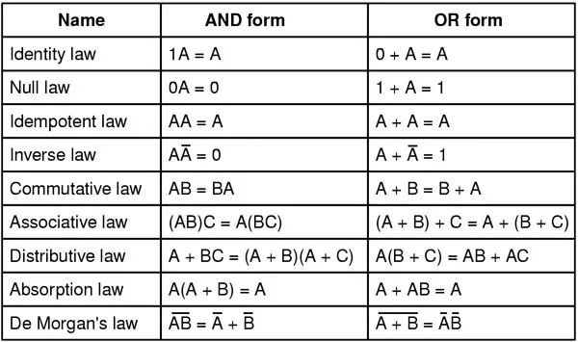
Boolean algebra

Slide 38
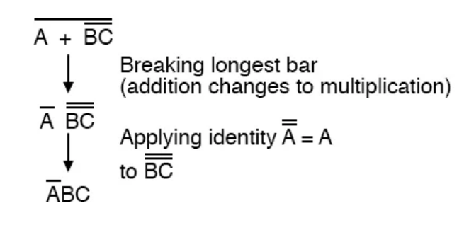
Duality in Boolean Algebra
Starting with a Boolean relation, we can derive another Boolean relation by-
Changing each OR (+) sign to an AND (.) sign
Changing each AND (.) sign to an OR (+) sign.
Complementary each 0 and 1
For example:
A + 0 = A
The dual relation is A.1 = A
Since, A (B + C) = AB + AC (by distributive law).
Its dual relation is A + B C = (A + B) (A + C)
De Morgan’s Law
De Morgan's first theorem states: The complement of a product is equal to the sum of the complements.
De Morgan’s second theorem states: The complement of a sum is equal to the product of the complements.
To illustrate, let’s take the expression (A + (BC)’)’ and reduce it using DeMorgan’s Theorems:

Slide 39
Example : Simplify the following Boolean expression: (A + B).(A + C).
Solution:
Let us simplify the given Boolean expression (A + B).(A + C) using relevant Boolean laws.
Proof | Boolean Laws
(A + B).(A + C) = AA + AC + BA + BC | Distributive law
= A + AC + AB + BC | Idempotent AND law and commutative AND law
= A + AB + BC | Absorption law (A + AC = A)
= A + BC | Absorption law

Slide 40
Example
Using Boolean algebra techniques, simplify this expression:
AB + A(B + C) + B(B + C)
Step 1: Apply the distributive law to the second and third terms in the expression, as follows:
AB + AB + AC + BB + BC
Step 2: Since, (BB = B)
AB + AB + AC + B + BC
Step 3: Apply (AB + AB = AB) to the first two terms.
AB + AC + B + BC
Step 4: Apply (B + BC = B) to the last two terms.
AB + AC + B
Step 5: Apply (AB + B = B) to the first and third terms.
B+AC
At this point the expression is simplified as much as possible

Slide 41
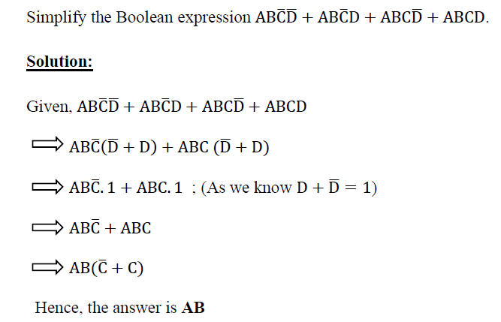
Example

Slide 42
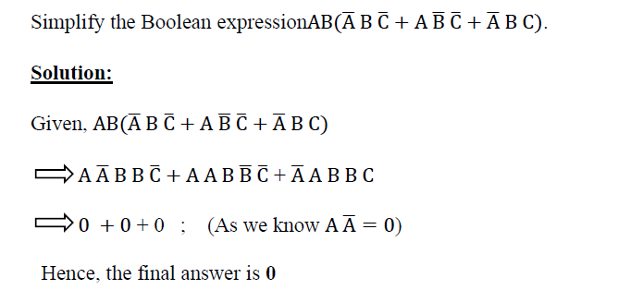
Using inverse law

Slide 43
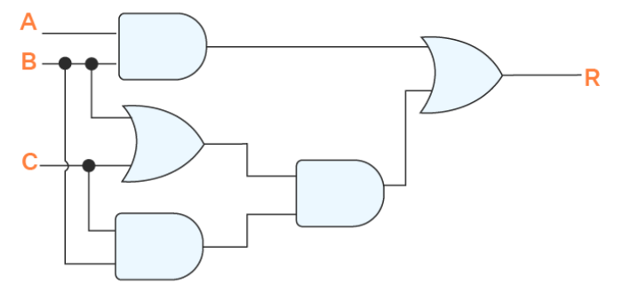
Example 2: Simplify the logic circuit using Boolean algebra.

Slide 44
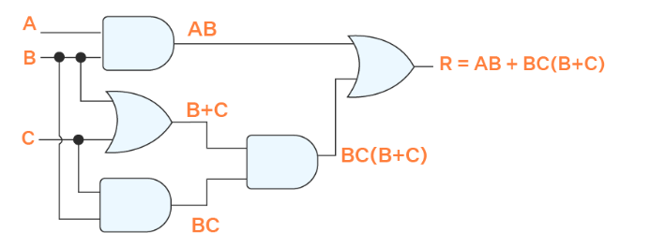
On solving the expression AB + BC(B + C) = AB + BBC + BCC.
Applying A.A = A we get AB + BC + BC.
Applying A + A = A we get AB + BC = B(A + C).
Answer: B(A + C)

Slide 45
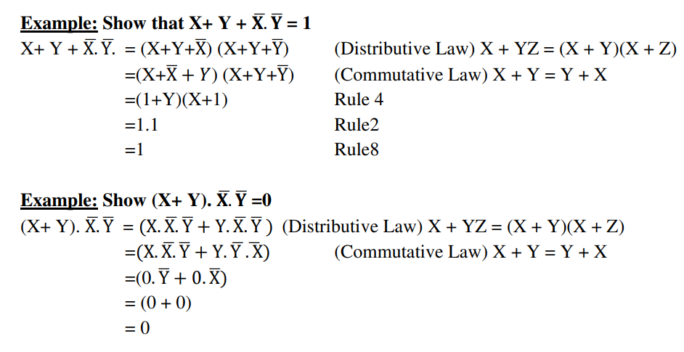

Slide 46
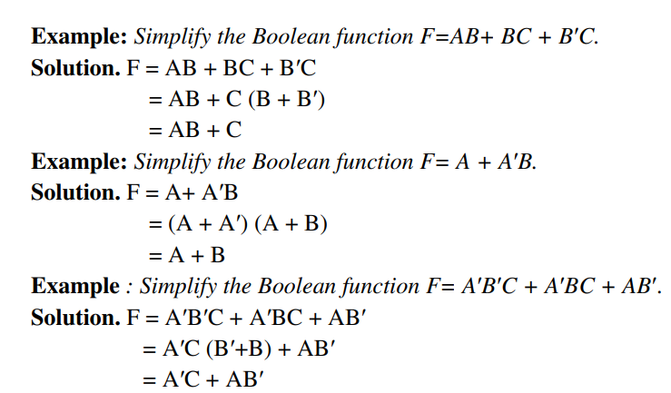

Slide 47
SOP and POS Representation for Logic Expressions
SOP:
SOP stands for Sum of Product. SOP form is a set of product (AND) terms that are summed(OR) together. When an expression or term is represented in a sum of binary terms known as minterms and sum of products.
Ex: F (A, B, C) = ∑m (0, 2, 5, 7, 8)
POS:
POS stands for product of sum. A technique of explaining a Boolean expression through a set of max terms or sum terms, is known as POS(product of sum).
F (A, B, C) = ∏ M (3, 5, 7, 8)

Slide 48
 | SOP | POS
1 | SOP stands for Sum of Products. | POS stands for Product of Sums.
2 | It is a technique of defining the boolean terms as the sum of product terms. | It is a technique of defining boolean terms as a product of sum terms.
3 | It prefers minterms. | It prefers maxterms.
4 | In the case of SOP, the minterms are defined as ‘m’. | In the case of POS, the Maxterms are defined as ‘M’
5 | It gives HIGH(1) output. | It gives LOW(0) output.
6 | In SOP, we can get the final term by adding the product terms. | In POS, we can get the final term by multiplying the sum terms.
 | Minterms: ABC + BC+ A C | Maxterms: (B + A) (B + C) (B + C)

Slide 49
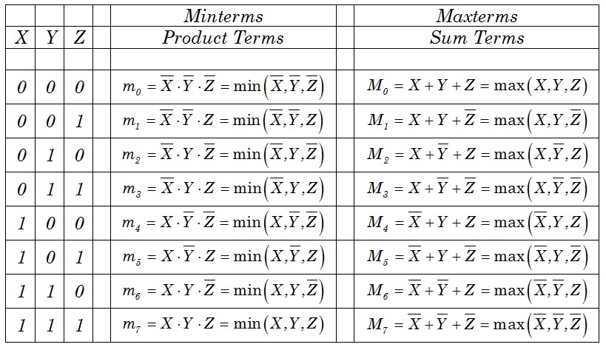
Truth table representing minterm and maxterm –

Slide 50
Canonical Form –
In Boolean algebra, Boolean function can be expressed as Canonical Form known as minterm and maxterm.
F = ∑ m1 + m4 + m5 + m6 + m7
SOP is represented as ∑(1, 4, 5, 6, 7)
.
Standard Form (Non-Canonical form)–
A Boolean variable can be expressed in either true form or complemented form. In standard form Boolean function will contain all the variables in either true form or complemented form while in canonical number of variables depends on the output of SOP or POS.
F = A + B’C

Slide 51
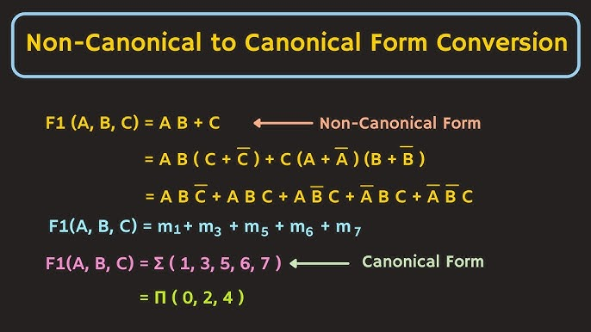

Slide 52
Example – Express the Boolean function F = A + B’C as standard sum of minterms.
A = A(B + B’) (C + C’) = AB + AB’ (C + C’) : This function is still missing one variable, so
A = ABC + ABC’+ AB’C + AB’C’
The second term B’C is missing one variable; hence,
B’C = B’C(A + A’) = AB’C + A’B’C
Combining all terms, we have F = A + B’C = ABC + ABC’ + AB’C + AB’C’ + AB’C + A’B’C
But AB’C appears twice, and according to theorem 1 (A + A = A), it is possible to remove one of those occurrences.
Rearranging the minterms in ascending order, we finally obtain
F = A’B’C + AB’C’ + AB’C + ABC’ + ABC
= m1 + m4 + m5 + m6 + m7
SOP is represented as Sigma(1, 4, 5, 6, 7)

Slide 53
Karnaugh map (K-Map) Karnaugh map or K-map is a map of a function used in a technique used for minimization or simplification of a Boolean expression. It results in less number of logic gates and inputs to be used during the fabrication.
Rules of Minimization in K-Map
You can either make groups of 1’s or 0’s but not both.
Grouping of 1’s lead to Sum of Product form and Grouping of 0’s lead to product of Sum form.
Groups can be made vertically and horizontally but not diagonally.
Groups made should be as large as possible even if they overlap.
Uppermost & lowermost squares can be made into a group together as they are adjacent (1-bit difference). Same goes for the corner squares.
Each group represents a term in the Boolean expression. Larger the group, smaller and simple the term.
The product of those literals that remains unchanged in a single group makes the term of the expression.
Don’t care “x” should also be included while grouping to make a larger possible group.

Slide 54
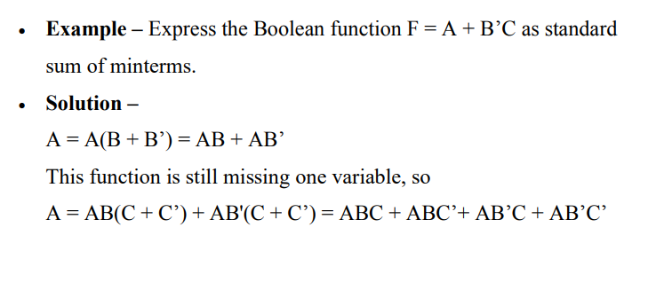
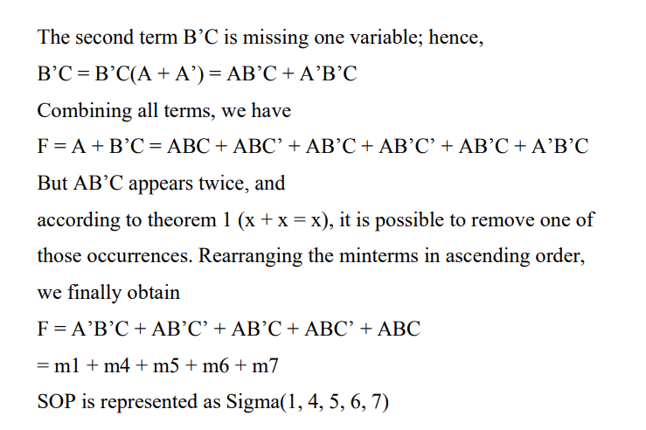

Slide 55
Solving an Expression Using K-Map
Here are the steps that are used to solve an expression using the K-map method:
1. Select a K-map according to the total number of variables.
2. Identify maxterms or minterms as given in the problem.
3. For SOP, put the 1’s in the blocks of the K-map with respect to the minterms (elsewhere 0’s).
4. For POS, putting 0’s in the blocks of the K-map with respect to the maxterms (elsewhere 1’s).
5. Making rectangular groups that contain the total terms in the power of two, such as 2,4,8 ..(except 1) and trying to cover as many numbers of elements as we can in a single group.
6. From the groups that have been created in step 5, find the product terms and then sum them up for the SOP form.

Slide 56
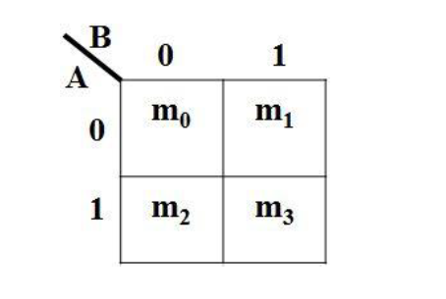
2-Variable K-Map
2 variables have 2n = 22 = 4 minterms. Therefore, there are 4 cells (squares) in 2 variable K-map for each minterms.
Consider A & B as two variables.

Slide 57
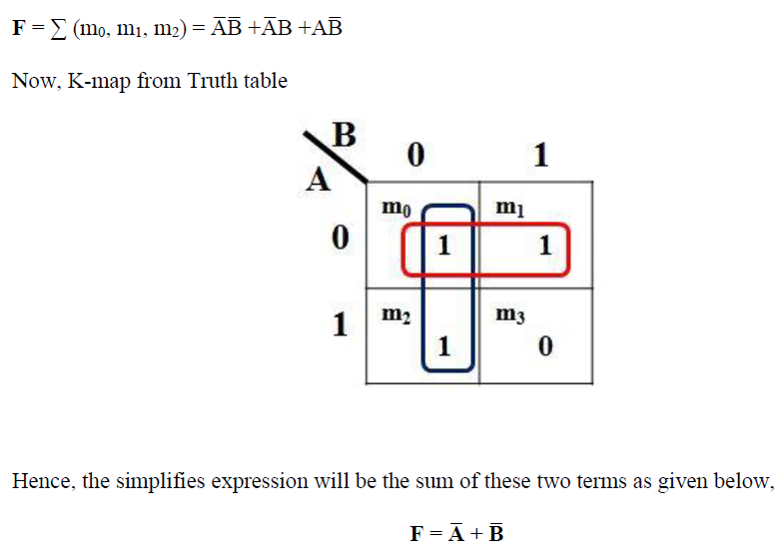
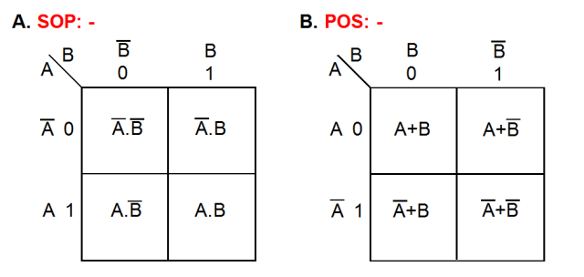
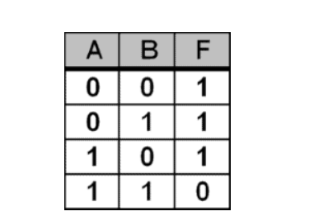
SOP FORM

Slide 58
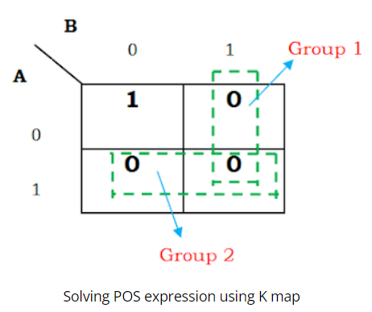
POS FORM
f(A,B) =∏M(1,2,3)
In group 1, the cells 1 and 3 are grouped and the common term is B. In group 2, cells 2 and 3 are grouped and the common term is A.
So the minimized POS expression is f(A,B) =B’.A’

Slide 59
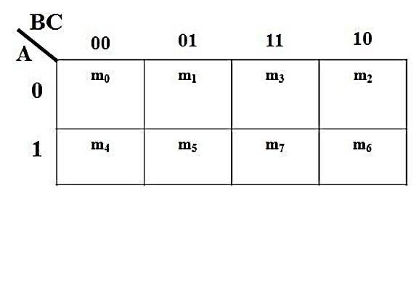
3-Variable K-Map variables make 8 min terms, so the K- map of 3 variables will have 8 squares(cells) as shown in the figure given below.

Slide 60
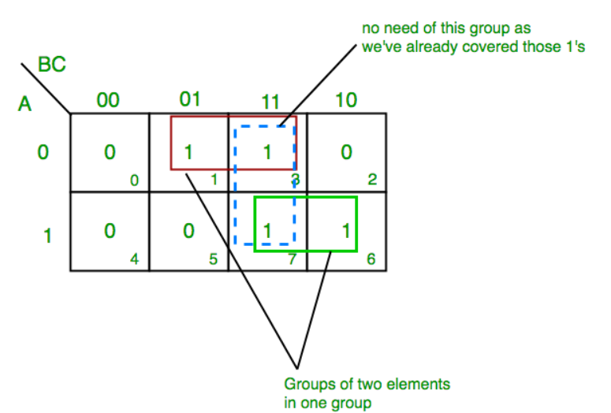
SOP FORM
Example of 3 Variable K-Map:
Simplify the given function using K-map. F= ∑ A,B,C(1,3,6,7)
F = (A’C+AB)

Slide 61
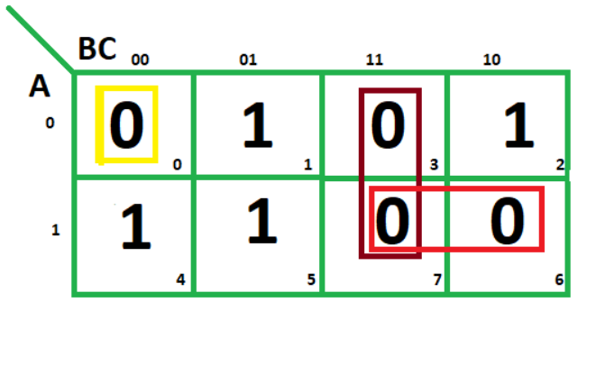
POS FORM: K-map of 3 variables
F(A,B,C)=∏(0,3,6,7)

Slide 62
1. From red group we find terms : A B
Taking complement of these two : A' B'
Now sum up them
(A' + B’)
2. From brown group we find terms : B C
Taking complement of these two terms : B’ C’
Now sum up them
(B’+C’)
3. From yellow group we find terms : A' B' C’
Taking complement of these two : A B C
Now sum up them
(A + B + C)
We will take product of these three terms : Final expression – (A' + B’) (B’ + C’) (A + B + C)

Slide 63
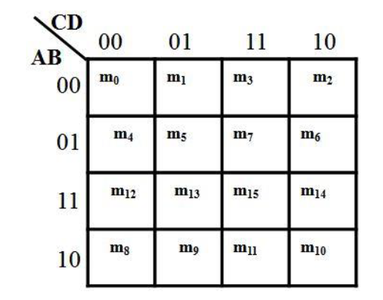
4-Variable K-Map
Four variables have 16 minterms. So, a 4-variable k-map will have 16 cells as shown in the figure given below.

Slide 64
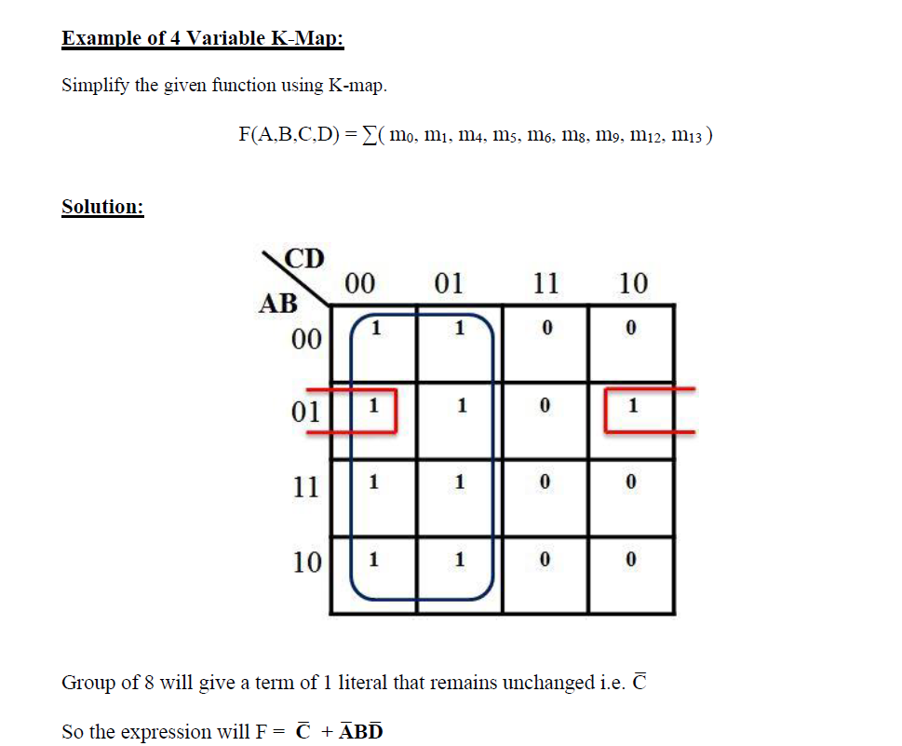
SOP FORM

Slide 65
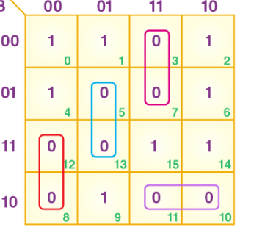
POS FORM
4 variables K-map
F (P, Q, R, S) = π (3, 5, 7, 8, 10, 11, 12, 13)

Slide 66
From the blue group, the terms would be
R’ S Q
We take their complement and then sum them
(R + S’+ Q’)
From the purple group, the terms would be
R S P
We take their complement and then sum them
(R’ + S’+ P’)
From the red group, the terms would be
P R’ S’
We take their complement and then sum them
(P’ + R + S)
From the lilac group, the terms would be
P Q’ R
We take their complement and then sum them
(P’ + Q + R’)
Finally, we will express these in the form of the product –
(R + S’+ Q’).(R’ + S’+A).(P’+ R + S).(P’+ Q + R’)

Slide 67
Question: Simplify the following function using K map
F(A, B, C, D) = Σ(1, 3, 4, 5, 6, 7, 9, 11, 13, 15)
Also implement the simplified function using basic gates only.

Slide 68
Five Variable K-Map
A five variable K-map is used to minimize a 5-variable Boolean expression to its reduced form. The following are the important characteristics of a 5 variable K-map.
A five variable K-map have 32 (2⁵) cells or squares, and each cell of the K-map represents either a minterm or a maxterm of the Boolean expression.
In the five variable K-map, we can form 2-squares, 4-squares, 8-squares, 16-squares, or 32-squares by involving its two blocks. Also, squares are considered adjacent in these two blocks, when one block superimposes on the top of another.

Slide 69
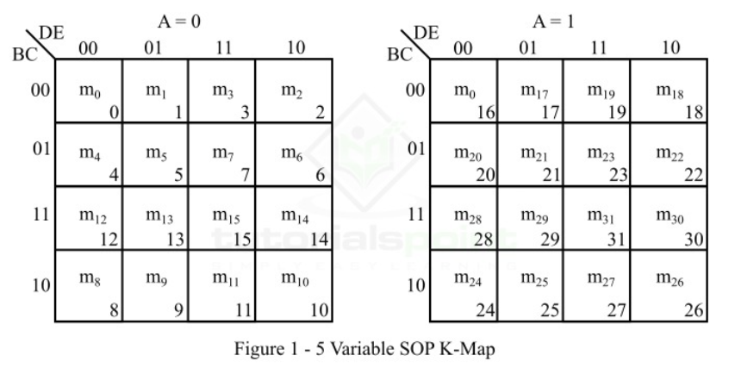

Slide 70
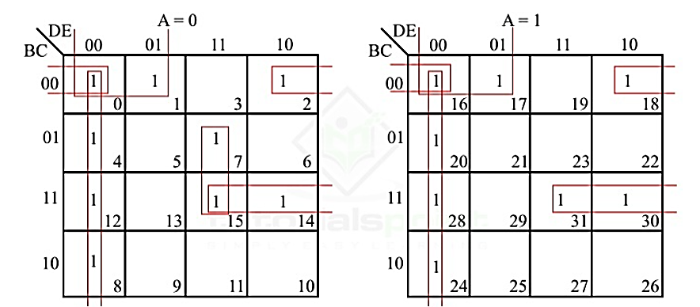
Example 1
Reduce the following 5 variable Boolean function in SOP form using the five variable K map.
f⟮A,B,C,D,E⟯=∑m⟮0,1,2,4,7,8,12,14,15,16,17,18,20,24,28,30,31⟯
⟮D’E’⟯
B’C’D’
B’C’E’
A’CDE
BCD

